Slide 1
YAMM
Yet Another Memory Manager
Andrei Vintila
AMIQ Consulting
June 28, 2016
Grenoble, France

Slide 2
Agenda
Theory
Memory Management Introduction
YAMM Overview: Features, Algorithm, Data types, API
Comparison with UVM_MAM
Feature-wise
Performance-wise
Examples

Slide 3
Memory Management
Introduction

Slide 4
Memory Management – What is it?

Slide 5
Memory Management Requirements
Real Life | Verification
Provide memory buffers to programs | Support real life use cases
Prevent memory corruption | Provide randomization support
Reduce fragmentation | Provide debug support
 | Not necessarily a memory model

Slide 6
YAMM
Overview

Slide 7
YAMM
Features (1)
Everything is a buffer, either it’s a free one or a user defined one
YAMM provides API for retrieval of allocated buffers
Buffers can be allocated using a specific allocation mode
User can set different granularities and address alignments
YAMM has the ability to store contents or generate random contents inside used buffers
Notes:
Memory Map
The memory is initialized after reset as a free buffer containing the entire memory space.
Memory allocation is done by splitting and moving space from the free buffer to new occupied buffers
Every buffer allocated in memory is responsible for it’s address space. Contents can be allocated directly in the buffer or other buffers can be allocated for that address space.
The memory can be segmented in as many pieces and on as many levels as the user want limited only by the memory size.
As was described earlier there are 4 ways of reserving buffers in memory and 6 allocation modes. This way YAMM can be suitable for any type of project.
Both insertion and allocation have 2 ways of usage
Giving a buffer as an argument, which was prior created by the user
An easy mode that takes a starting address and a size through an access (insert), or just a size as argument (allocate) and returns the created buffer.

Slide 8
YAMM
Features (2)
Buffers represent address spaces themselves
Memory can be dumped to file or can be returned in a readable form as a string
It provides functions to check the statistics of a specific memory space
Can be extended for specific use cases

Slide 9
YAMM
Data Types
yamm_buffer
Contains all data and functions
yamm
Top level class in the hierarchy
Inherits from yamm_buffer and implements specific functionality required for top level
yamm_access
Optional usage
Used to model a basic access (start address, size)
Notes:
YAMM
After instantiation memory can be built with a specific size and name.
After building the memory, before calling reset() static buffers can be allocated
Calling reset creates the free buffer for the entire memory span and allocates the static buffers
Calling reset a second time brings the memory to the initial state (After static buffers allocation)
YAMM BUFFER
There are functions for allocating, deallocating, searching, setting and reading content
Any buffer can act the same way as the entire memory. It’s memory span becomes accessible as a free buffer inside which you can allocate other buffers. This also works for static buffers to which the user possesses a reference..

Slide 10
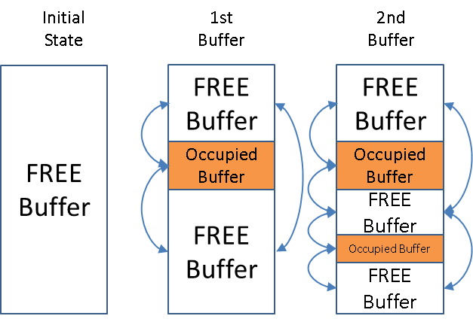
YAMM Overview
Algorithm
After initialization the memory map will contain a single free buffer
All buffers in a memory map are chained in a double linked list

Slide 11
YAMM Overview
API
Allocation
Manual allocation: insertion
Automatic allocation rules:
RANDOM_FIT
FIRST_FIT (and FIRST_FIT_RND)
BEST_FIT (and BEST_FIT_RND)
UNIFORM_FIT
Deallocation
It can be done on a specific buffer or address

Slide 12
YAMM Overview
API - Allocation/Deallocation
Notes:
After a build was done the parameters for the memory are set but the free buffer is not yet created, the memory can’t yet be used for normal allocations.
At this time, before reset static buffers can be allocated. This is the first step. Initially, after a reset is done the memory will look as it is pictured in the rightmost memory space.
After the reset buffers can be allocated and deallocated normally.
Between the 2nd and 3rd memory spaces you can see how a deallocation takes place. The buffers is replaced by a free buffer that is merged with the adjacent free buffers.
Doing another reset afterwards will result in the memory being returned to the state it was after allocating the static buffers.

Slide 13
YAMM Overview
API
Search functions
Retrieve buffers by name
Retrieve buffer by address
Retrieve buffers in address range
Retrieve buffers by access
Debug functions
Return the memory map allocation as a string
Dump memory map to file
Provide usage and fragmentation statistics
Notes:
Get_all_buffers_by_type
User can assign names to specific buffers using set_name() function
A queue with said buffers can be returned calling the get_all_buffer_by_type() function using the name set to those buffers as an argument.
Get_buffer
Using an address as an argument get_buffer() function return the buffer that contain that address
Get_buffers_in_range
Specifying a start and end address get_buffers_in_range() will return a queue with all buffers in that memory region
Get_buffers_by_access
Same as the previous, it actually does a call to get_buffers_in_range() but it gets its region from an access instead of it being specified by the user.

Slide 14
Comparison with UVM MAM

Slide 15
MAM
UVM solution
The solution is oriented more towards memory modeling than memory management
MAM plays a small role and is used with uvm_mem to reserve specific memory regions
Supports only “greedy” allocation mode
Specific regions can be freed or entire memory can be wiped
Memory state can be returned as a string
Notes:
Complex and general solution
It’s composed of a large number of objects, each with a specific use
Organized hierarchically, many of the features are hard to access
Massive overhead, not useful for cases in which memory management is solely required
It prioritizes complexity and reusability rather than performance or ease of use
Coverage support!

Slide 16
MAM vs YAMM
Feature wise (1)
MAM
Memory
uvm_mam is linked to uvm_mem which provides the mam memory locations used for storing data
Allocation
Can only allocate on previously unallocated memory
Has only 2 allocation modes
Deallocation
Releases the specific region
YAMM
Memory
YAMM top level as well as every individual buffer contains a memory map composed of multiple buffers that can store simple data
Allocation
Permits allocation in previously unallocated memory or inside an already allocated buffer
Has 6 allocation modes
Deallocation
Can display a warning if said buffer contains other buffers

Slide 17
MAM vs YAMM
Feature wise (2)
MAM
Finding buffers
Provides an iterator that user must use for any needs
Ease of use
It’s complex and rather hard to use
For features beyond reserving and freeing regions user has to go to objects higher in the hierarchy
YAMM
Finding buffers
Provides support for finding and modifying buffers by different criteria
Ease of use
Has a more user friendly API
Memory map can be accessed by calling functions on the top level
Specific regions can be accessed by calling same functions on the chosen buffers

Slide 18
Performance test
Parameters
Memory space of 1G
Allocate 5000 buffers of size 100
Measure the time taken for allocation every 100 allocations
For MAM, request_region() with default policy was used (it will randomly allocate only memory that wasn’t previously allocated)
For YAMM, allocate_by_size() with RANDOM_FIT allocation mode was used

Slide 19
Performance - MAM vs YAMM
more than 200x speed

Slide 20
Examples

Slide 21
Examples
Configuration Example
yamm new_memory;
yamm_size_width memory_size = 10000;
new_memory = new;
new_memory.build(“memory_name”, memory_size);
// Now you can allocate static buffers. The memory was created but buffers
// can't be allocated yet. After reset(), normal buffers can be allocated but static
// buffers can't.
new_memory.reset();

Slide 22
Examples
Sequence Example
class user_sequence extends uvm_sequence;
rand int unsigned access_size;
...
task body();
yamm_buffer buffer = p_sequencer.user_memory.allocate_by_size(access_size);
`uvm_do_with(user_item, {
address == buffer.start_addr;
size == buffer.size;//or access_size
data == buffer.get_contents();
})
endtask
endclass

Slide 23
Examples
Scoreboard Example
class user_scoreboard;
yamm user_memory;
...
//function checks if the current access is done to a previously allocated address
function void check_access(user_item item);
if(user_memory.get_buffer(item.addr) == null)
`uvm_error(get_name(), "Access detected to a non-allocated memory address!")
endfunction
endclass

Slide 24
YAMM Availability
Free under Apache 2.0 license
Available after SNUG conferences
Blog: www.amiq.com/consulting/blog
Github: github.com/amiq-consulting

Slide 25
Questions?

