Slide 1
YAMM Yet Another Memory Manager
Andrei Vintila, Ionut Tolea
Amiq Consulting

Slide 2
Agenda
Theory
Memory Management Introduction
YAMM Overview: Features, Algorithm, Datatypes, API
Comparison with UVM_MAM
Feature-wise
Performance-wise
Examples

Slide 3
Memory Management – What is it?

Slide 4
Memory Management Requirements
Real Life | Verification
Provide memory buffers to programs | Support real life use cases
Prevent memory corruption | Provide randomization support
Reduce fragmentation | Provide debug support
 | Not necessarily a memory model

Slide 5
YAMM Features (1)
Implementations for SystemVerilog, C++
Everything is a buffer
Provides API for retrieval of allocated buffers
Supports multiple allocation modes
Supports memory granularity and address alignment
Provides buffer content management

Slide 6
YAMM Features (2)
Buffers represent address spaces themselves
Memory can be written to file or pretty-printed
Provides usage and fragmentation statistics
Can be easily extended for specific use cases

Slide 7
YAMM Data Types
yamm_buffer
Contains all data and functions
yamm
Top level instance of the memory manager
Inherits yamm_buffer
yamm_access
Optional usage
Used to model a basic access (start address, size)

Slide 8
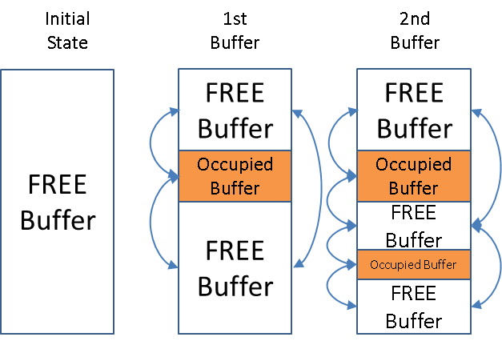
YAMM Overview - Algorithm
After initialization the memory map will contain a single FREE buffer
All buffers in a memory map are chained in a double linked list

Slide 9
YAMM Overview – API (1)
Allocation
Manual allocation: insertion
Automatic allocation rules:
RANDOM_FIT
FIRST_FIT (and FIRST_FIT_RND)
BEST_FIT (and BEST_FIT_RND)
UNIFORM_FIT
Deallocation
It can be done on a specific buffer or address

Slide 10
YAMM Overview – API (2)

Slide 11
YAMM Overview – API (3)
Search functions
Retrieve buffers by name
Retrieve buffers by address
Retrieve buffers in address range
Retrieve buffers by access
Debug functions
Return the memory map allocation as a string
Dump memory map to file
Provide usage and fragmentation statistics

Slide 12
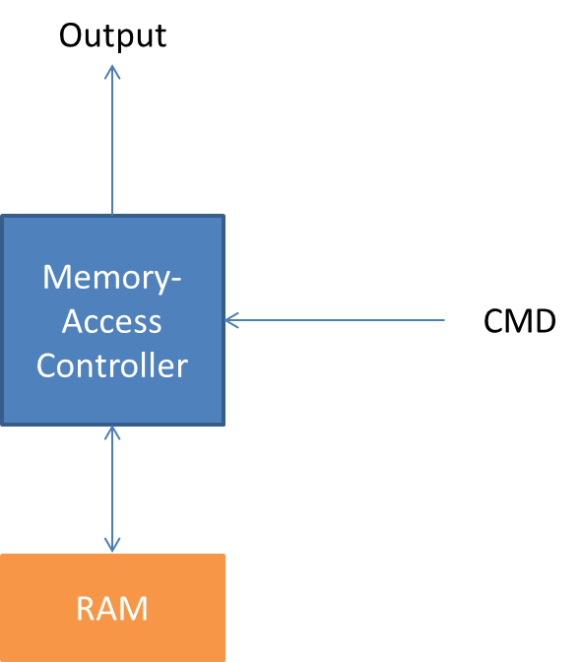
YAMM – Use case
A typical use case would be a DUT that handles accesses to a memory with specific priorities.
When using constraint random overlapping accesses can be generated which increases the difficulty of checking.

Slide 13
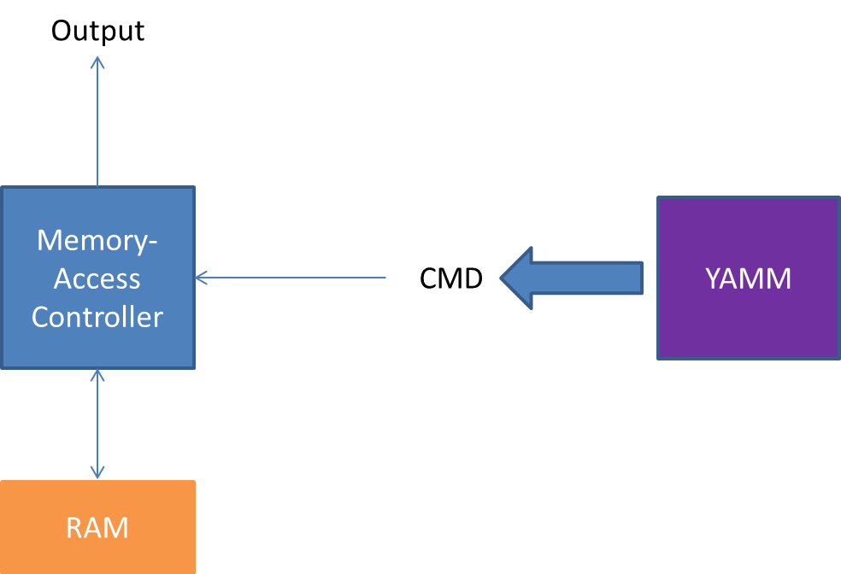
YAMM – Use case (2)
YAMM can be easily used to generate interesting scenarios, by providing the buffers in which the accesses are done (address and size)

Slide 14
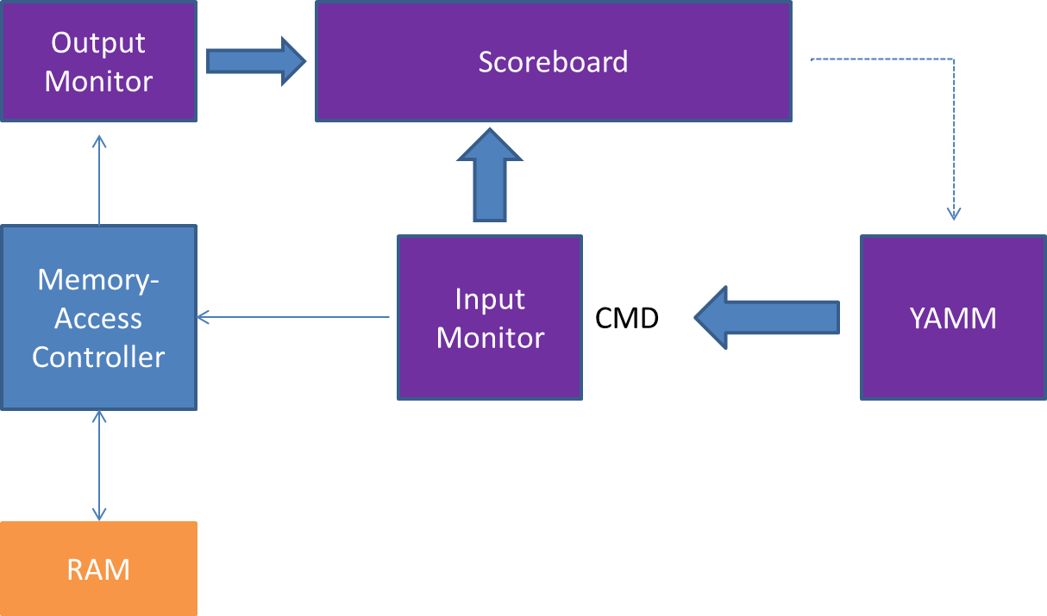
YAMM – Use case (3)
Checking is made much easier when YAMM is used to control the buffers in which the writes/reads are done.

Slide 15
MAM – UVM Solution
Oriented towards memory modeling
MAM is used with UVM_MEM to reserve specific memory regions
Supports only “greedy” allocation mode
Specific regions can be freed or entire memory can be wiped
Memory state can be returned as a string

Slide 16
MAM vs YAMM – Feature Wise (1)
Memory
UVM_MAM is linked to UVM_MEM which provides the memory locations used for storing data
YAMM top level as well as every individual buffer contains a memory map composed of multiple buffers that can store simple data
Allocation
UVM_MAM can only allocate on previously unallocated memory (2 allocation modes)
YAMM can allocate new buffers in either unallocated memory or inside an already allocated buffer (6 allocation modes)

Slide 17
MAM vs YAMM – Feature Wise (2)
Finding buffers
UVM_MAM provides only an iterator; user must implement the search functions
YAMM provides support for finding and modifying buffers by different criteria

Slide 18
MAM vs YAMM – Feature Wise (3)
Ease of use
UVM_MAM is complex and rather hard to use and for features beyond reserving and freeing regions user has to go to objects higher in hierarchy
YAMM has a more user friendly API, memory map can be accessed by calling functions on the top level and also specific regions can be accessed by calling same functions on the chosen buffers

Slide 19
Performance test - Parameters
Memory space of 1G
Allocation of 5000 buffers of size 100
Measuring the time taken for allocation every 100 allocations
For MAM, request_region() with default policy
For YAMM, allocate_by_size() with RANDOM_FIT allocation mode was used

Slide 20
Performance test – MAM vs YAMM
More than 200x the speed

Slide 21
Examples – Initialization Example
yamm new_memory;
yamm_size_width memory_size = 10000;
new_memory = new;
new_memory.build(“memory_name”, memory_size);

Slide 22
Examples – Sequence Example
class user_sequence extends uvm_sequence;
rand int unsigned access_size;
...
task body();
yamm_buffer buffer = p_sequencer.user_memory.allocate_by_size(access_size);
`uvm_do_with(user_item, {
address == buffer.get_start_addr();
size == buffer.get_size();
data == buffer.get_contents();
})
endtask
endclass

Slide 23
Examples – Scoreboard example
class user_scoreboard;
yamm user_memory;
...
//function checks if the current access is done to a previously allocated address
function void check_access(user_item item);
if(user_memory.get_buffer(item.addr) == null)
`uvm_error(get_name(), "Access detected to a non-allocated memory address!")
endfunction
endclass

Slide 24
YAMM Availability
Open Source under Apache 2.0 license
Available in both SystemVerilog and C++ as well
Blog: www.amiq.com/consulting/blog
Github: www.github.com/amiq-consulting/yamm

Slide 25
Questions

